Slide 1
DEI BASICS

Slide 2
COURAGEOUS SPACE AGREEMENT
Respect
Open minded. No speaking over one another. Speak kindly. Assume good intention. Work and issue, not a person.
Take Responsibility
Speak in the “I.” Own your words. Follow through. It’s ok to have challenging conversations.
Listen to Understand
Oops. Ouch. Listen with the same passion you have for being heard.
Make Room for All Voices
Lean In. Lean Out.
Trust the Process
Remember growth hurts. Get comfortable with being uncomfortable.
Protect the Integrity of Stories
Vegas rules apply. What is shared here stays here and what is learned here leaves here.

Slide 3
Comfort zone
Notes:
Comfort Zone: We all have zones of comfort about different topics or activities. During today’s learning we are going to ask everyone to move beyond traditional areas of comfort so that we are open to new challenges, knowledge, and awareness.
Moving outside of our comfort zones requires courage to constructively embrace differences. That courage allows us to continue learning even when we are have reached the point where we are uncomfortable.

Slide 4
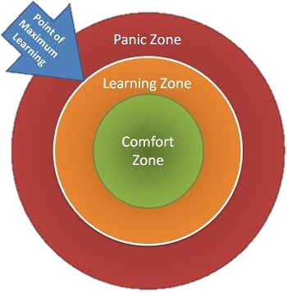
Learning Zone
Notes:
Learning Edge: This point of discomfort is called the learning edge because it is the best place to expand understanding, take in new perspectives, and strengthen awareness.
While on our learning edge we may feel annoyed, angry, anxious, surprised, confused, defensive, or in some other way uncomfortable. These reactions are signs that our way of seeing things is being challenged. If we retreat to our comfort zone, by dismissing whatever we encounter that does not agree with our way of seeing the world, we lose an opportunity to expand our understanding. The challenge is to acknowledge “your” learning edge, lean into the discomfort, and see what you can learn.

Slide 5


TRIGGERS
PHRASES
ACTIONS
Notes:
Triggers are words, phrases, or topics that evoke an emotional response because they are associated with anger, hurt, trauma and/or a past pain about issues of oppression.
During this learning, any of us may be triggered. We should be aware of our triggers and how we respond. Responses may be physical, emotional, verbal, or any combination thereof.
Words: racist or privilege
Phrases: That’s retarded.
Actions: When people touch my hair.
Topics: politics, religion, race

Slide 6







WHAT IS DIVERSITY
Socioeconomic Status
Language
Race
Experience
Age
Gender
Skills
Notes:
Diversity is reality! ”Diversity” is the word or label we have used as a placeholder to describe the many identities and factors that shape us, others, and our experiences. It includes all the ways in which people differ and encompasses all the different characteristics that make one individual or group different from another.
While by no means an exhaustive list, this includes ethnicity, gender identity, gender expression, religion, disability, sexual orientation, education, marital status, physical appearance, ideas, perspectives, and values.
Diversity isn’t an option or an agenda – it simply is.
We used to talk about America being a melting pot. But that implies that we all start to blend together to be the same. I like to think of SLCH as a flavorful pot of stew with many flavors. Each of you are a different spice. If you were all salt, it would be a terrible stew. So often, we encourage you to bring you own spice to the table. We don’t want all salt. We want all the wonderful diversity of flavors and opinions that you each bring.

Slide 7
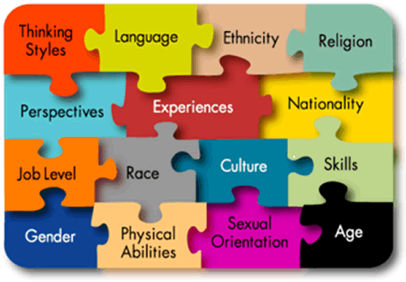
WHAT IS INCULSION
EMPOWERMENT
INVOLVMENT
Notes:
We define inclusion as the process of creating involvement, environments, and empowerment in which any individual or group can be and feel welcomed, respected, supported, and valued to fully participate. An inclusive and welcoming climate with equal access to opportunities and resources that embraces differences and offers respect in words and actions for all people. The process of respectfully (not in a tokenizing or exploitative manner) utilizing all the dimensions of diversity in order to fulfill a given organization's mission and vision.
Because we have inherited exclusive and unjust systems, inclusion often means that we must take thoughtful, intentional action to make sure we don’t keep replicating past harms. (Remember the “geographic separation” policy from our timeline? That is a prime example)

Slide 8
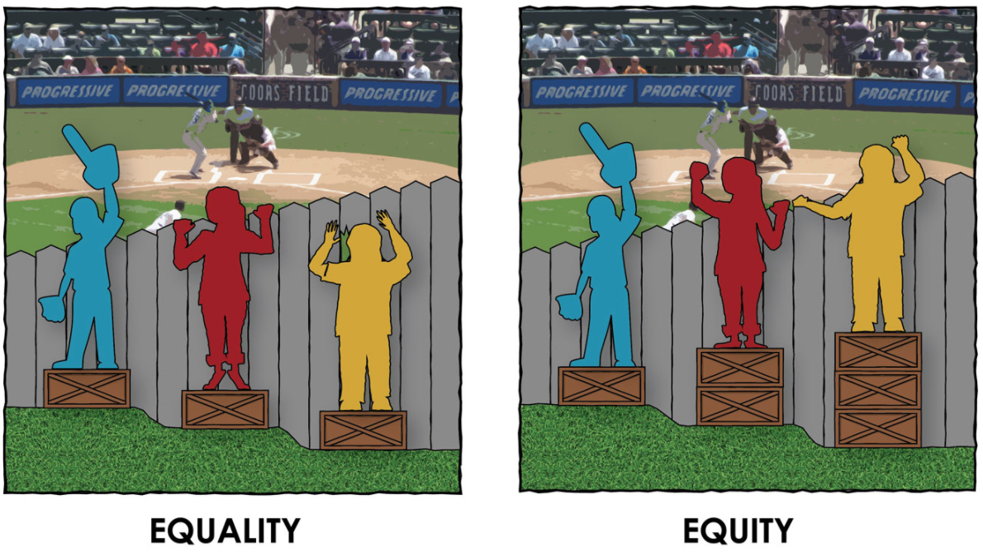
WHAT IS EQUITY
What is the difference between
EQAULITY and EQUITY.
Graphic from Paul Kuttner, https://culturalorganizing.org/the-problem-with-that-equity-vs-equality-graphic/
Notes:
Equity is the most important piece of our talk today. So many people, specifically white people, are socialized to the idea of equality. “I treat everyone the same.” is the second most dangerous phrase in medicine. Equity is what address the inequity of equality. Equity is not about everyone getting the exact same treatment. It’s about everyone getting the same outcome and us doing our part to get them to that same outcome. So, think about this way, how many different types of medication exist to treat high blood pressure (diuretics, beta-blockers, ACE inhibitors, calcium channel blockers, alpha blockers, etc.)? Why do you think that’s so? People’s bodies metabolize things differently so one treatment is inadequate and possibly harmful. Patients, families, your co-workers, family…no one is one size fits all.
The guarantee of fair treatment, access, opportunity and advancement while at the same time striving to identify and eliminate barriers that have prevented the full participation of some groups. The principle of equity acknowledges that there are historically underserved and underrepresented populations and that fairness regarding these unbalanced conditions is needed to assist equality in the provision of effective opportunities for all groups. Equity is a state of similar outcomes despite dissimilar initial influencing factors.
Equity is getting the same outcome. It’s about meeting people where THEY are and not judging them for where we want/expect them to be.
So, when we talk about health disparities or equitable care—this is what we are talking about.
This is the crux of the matter.

Slide 9
WHAT IS BIAS?
Conscious
AKA
Explicit
Biases are inward
thoughts and attitudes
either for or against someone
based on their characteristics.
Unconscious
AKA
Implicit
Notes:
Explicit biases are the very purposely harmful or hateful feelings and attitudes expressed through overt physical or verbal harassment and purposeful exclusion. These biases are acted on with the intent of causing harm. Unconscious biases are the learned ideas and stereotypes that are so deeply ingrained in our thinking that they are often our first thoughts or feelings about something or someone. Unconscious biases are products of our socialization that, most times, are meant to be protective.
We all approach our daily life with a suitcase of life lessons and experiences that we bring to our view of the world every minute of every day. This suitcase is influenced by these sources of bias, and many others that we are not even aware of. While some of us may have been deliberately taught by our caregivers to view others with suspicion, many of us learn to make these connections and assumptions slowly over time. For example, it’s been well documented that tall men are believed to be more successful than shorter men, that people of size are viewed as slovenly or unhealthy, that women are expected to be less assertive, and that professionals of color are often mistaken for support staff rather than their true role.

Slide 10
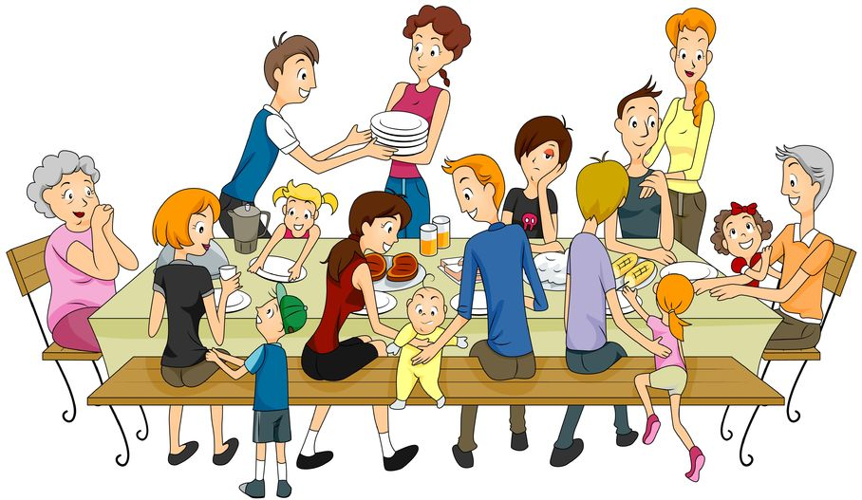



SOURCES OF BIAS
What are sources of unconscious
biases, stereotypes and assumptions??
Notes:
Where do our unconscious biases and stereotypes come from?
Think about the sources of these biases and assumptions.
“Dig deep” into yourself. Think about where you, or others, get their stereotypes and bias about other people..?
*Did a family member ever tell you to be suspicious of a particular kind of person?
*When have you heard a group of people described as “they/them/one of those”?
*If someone told you to ”keep to your kind,” what would they be referencing?
Although biases may be passively formed over time, we must work to actively address them. Passive, unquestioned biases give rise to biased behavior, also described as prejudice. If we want to avoid acting in prejudiced ways, we must examine our biases and consciously work to prevent them from influencing our behavior.
You may not be able to change your BIAS, but you can change your BEHAVIOR.

Slide 11
RACIAL EQUITY LENS…
The Ferguson Commission Report
Where we started.
Whom does this benefit?
Does this impact people/races differently?
What can mitigate racial inequity?

Slide 12
WHY RACE MATTERS
INTERSECTIONAL
ISOLATED
ABILITY
SEXUALITY
EDUCATION
AGE
RACE
INCOME
GENDER
RACE
GENDER
SEXUALITY
ABILITY
EDUCATION
AGE
INCOME

Slide 13
CASE STUDY 1:
NON-ENGLISH SPEAKING/ESL FAMILY
A family shows up to the check-in desk. It is their first appointment. They are a few minutes late after being turned around in the hospital. You greet them and ask for the patient's name. They smile and show you a piece of paper about their appointment. As you begin to ask them questions, mom starts speaking a language you can’t identify.
How do you help them?
What do they need to know?
Notes:
In this example we explicitly point to the language barrier. We could go even further to describe the family and get people thinking about even more biases that could pop up in their response.
i.e. a south-east Asian family, a Black family, a “white” family, an Asian family (what does that mean), a Mexican family (don’t say Latin X) → because we have to be honest that we have patience driven by our bias based on how people look

Slide 14
CASE STUDY 1: GUIDELINES
Non-English Speaking/ESL Families Fear and confusion
Ways to help: Attempt to determine which language they speak Utilize the unit translator iPads or (in a pinch) Google Translate Escort them to where they can wait or to the exam room Communicate with the tech, nurse and doctor team to ensure that the family has smooth transitions | Things that DO NOT help: Loud, slow talking AT them Pushing them to the side to take care of English-speaking people Assume they understand what they need to know (i.e., restroom locations, food, next steps)

Slide 15
CASE STUDY 2:
ANGRY PATIENTS/GUARDIANS/FAMILIES
You are in the exam space with a family doing vitals and your pre-check. This is the family’s 2nd visit in 2 weeks.
Mom (a Black woman) said last time (not to you) that:
She hates when people call her son “buddy”
She really hopes they get some good news because he really wants to get back to playing soccer.
You walk in and say, “Hey buddy. How are you today…” Mom is immediately upset. She explains she was just here last week (all the things above). You apologize. During your checks you hear mom calling her son ‘Bug’ and mention a soccer tournament coming up.
What are some things you can do to a) make a connection with the family and b) ensure that mom feels seen and heard

Slide 16
CASE STUDY 2: GUIDELINES
Angry Parents/Guardians/Families Fear, Frustration, and FEAR
Ways to help: Step 1: Take yourself out of it Step 2: Apologize and Acknowledge Step 3: Refocus the family on the here and now Step 4: Commit to connect P.A.U.S.E. | Things to remember: Historical Context Matters & It’s never about what it’s about.
Notes:
Step 1: Take yourself out of it. You know that you didn’t see this family last week. You know that mom did not talk to you. I know that its really hard to not get defensive when someone is yelling at you or upset with you for something YOU DID NOT DO. AND…that’s not what’s important right now. It’s not personal. This mom is feeling unheard. Why is that such a trigger for parents, specifically parents of chronically ill kiddos, even more specifically a Black mother (or any family of color)? That’s what needs to be the focus
Step 2: Apologize and acknowledge. Even though you are not technically, the one at fault you are at fault. Apologize. Acknowledge: “It has to be incredibly frustrating to have to constantly repeat yourself to our staff. We must do better about communicating what you need for your son/daughter/child.”
Step 3: Refocus the family. During times of high stress, which is the definition of the having a child with a chronic illness, consistency of any type is key. Remember that anger/outburst 99% of the time are not personal. Parents/guardians need to feel seen and heard and believe that we communicate with each other so that they believe their children are safe with us. While her upset may not be directly “your fault” it is your responsibility to reconcile in the moment. So, refocus. “Mom/Dad/etc. last week we dropped the ball, I can’t guarantee that we never do again but I today we are going to fix the things we can.”
Step 4: Connect. Tell mom/dad/guardian exactly what you are going to do to rectify the problem. “Mom I’m going to put a not in (insert kiddos name) chart so about calling him/her/them by their name and about his Rockstar soccer status so we can remain up to date for our soccer star. Also, (turn to kid and use their name) I heard your mom call you Bug. Is that a nickname for only you an mom? Is there a nickname you have with your friends that you want us to call you too?” Try to weave in as much soccer talk as possible. When the nurse or whomever enters introduce him as a soccer star. Get creative. Build bridges. Repair harm.
Things to remember: “It’s never about what it’s about”. We all have outside lives. We have baggage. There are a million other things that happen before we step foot inside this hospital and on top of that there’s a sick baby involved. Fear for parents is crippling. The lack of control they experience is devastating. You are often a reciprocal for their pain and frustration. It’s not fair but it’s also not about you. Keep that in mind as you PAUSE to find a solution to whatever the problem is.

Slide 17
CASE STUDY 3:
PERCEPTION OF
UNPROFESSIONAL BEHAVIOR
Family approaches the desk to sign in for their appointment.
There are 3 people behind the desk:
One person (a Black woman) is on the phone, having what seems to be a personal conversation.
Another person (young woman) is looking at something on the computer.
The other person (LatinX) is rummaging through a drawer.
The family (rural, white), after a 2-hour drive, is standing at the desk for 5 minutes before anyone acknowledges them. When they are acknowledged it’s by the person on the phone, who never stops their conversation and is just pointing at things for the parent to do. Mom is flustered/frustrated. The patient is crying and screaming that they are hungry. The person on the phone sighs loudly, tells mom they are checked in, and to have a seat. They have driven 2 hours to get here on time and the appointment is now 25 minutes behind. Mom is livid…
Notes:
What biases are playing into mom’s reactions
What biases are playing into how we respond – negatively or positively to mom’s reaction

Slide 18
CASE STUDY 3: GUIDELINES
Perception of Unprofessional Behavior Fear, Bias, Feeling ignored, disrespected or dismissed
Here is the reality of what was happening: The woman on the phone was actually talking to a parent having a break down about her child in crisis and is trying to comfort her and find resources for that mom. The woman on the computer is trying to coordinate a transfer for a clinic patient that needs to be admitted but the floor is full. The person looking through the drawer is looking for something…who knows | Things to consider: The identities of the people involved. Perception is reality If the shoe was on the foot and you had just driven 2 hours with a screaming child, in the rain, hit traffic, couldn’t find parking, waited in the screening line and were met with: An inattentive staff A packed waiting room And appointments running behind with no communication If you knew what was actually happening would it matter to you?

Slide 19
